Slide 1

B2B CART
PRESENTED BY TEAM LOSERS

Slide 2

B2B
WHAT ARE WE ?
we are a e-commerce platform focused to bring retail groceries directly from producers to local vendors. Our main customers are these local shops so we build an eco-system of supply chain for our customers

Slide 3
B2B
PROBLEMS WE SOLVE
Single platform for retailers to buy at Less
prices with credit system
1
2
Digital presence of the local shops
3
Profitable last mile delivery system

Slide 4

B2B
TARGET MARKET

Slide 5
B2B
SINGLE PLATFORM FOR RETAILERS TO BUY AT CHEAP PRICES WITH A CREDIT SYSTEM

Slide 6


B2B
OUR SERVICES
Digital presence of the local shops
Profitable last-mile delivery system for local shops

Slide 7
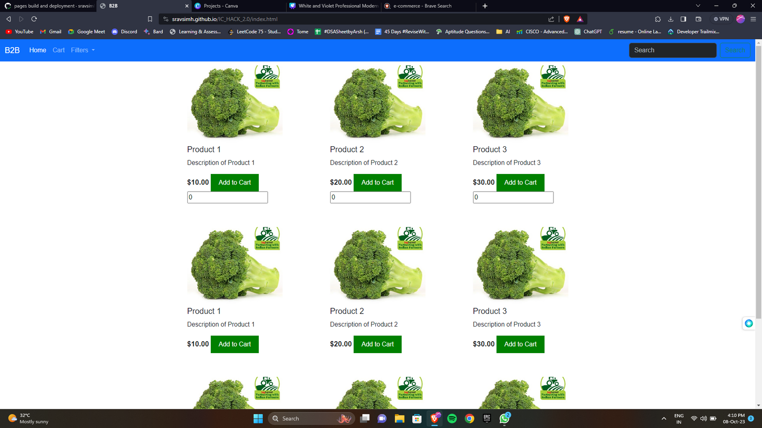
B2B
PROTOTYPE

Slide 8
B2B
THANK YOU

